Slide 1
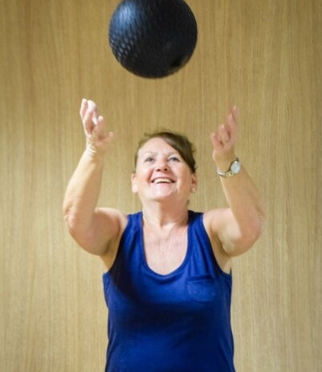


July 2023 Active Futures Cohort: free strength and balance classes with wellbeing support
Promoting independence in later life

Slide 2
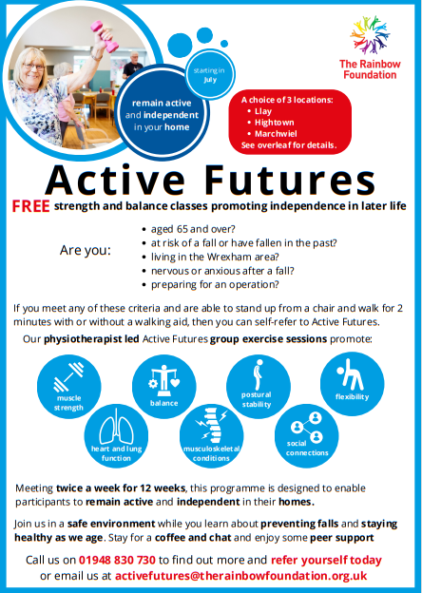
Intervention
Background
In the UK,
  30% of those age over 65 will fall at least once a year.
  50% of those over 80 will fall at least once a year.
Over 3 million people in the UK have osteoporosis and are at greater risk of fragility fractures. Every year, fragility fractures cost the NHS £1.1 billion in hospital stays (Department of Health, 2022).
Our Response
Free strength and balance classes promoting independence in later life and better health and wellbeing. The service is a collaboration between our Community Wellbeing Social Prescribers team and our Physiotherapists.
Aims
Effectively tackle frailty
Help improve MSK conditions
Reduced risk factors associated with surgery and the need for surgery
Improve mental health and wellbeing
Use peer support to drive positive behaviour change
Regular exercise can significantly reduce the risk of developing dementia by about 30 per cent

Slide 3
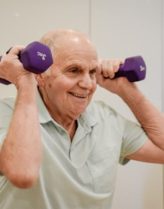
Service Offer
To deliver Active Futures across Wrexham; accessible to patients from Wrexham GP Surgeries who meet the criteria;
  Risk of falls or who have fallen
  Would benefit from preoperative preparation
  Have MSK conditions
9 x 12-week programme (3 programmes running in each cohort during Qtrs 2, 3, and 4 of 2023/24)
Each programme meets twice per week.
Free transport available to remove access barriers.
Each participant receives
  Physio led exercise at each session
  Social Prescriber support at each session to help build social capital and motivate the participants to better manage their health
    One to one casework and signposting to support ‘what matters most’ delivered outside the formal session via home visits
  A water bottle to improve hydration
  A course guidance pack which looks at overcoming frailty, how to recover from a fall, hydration and wider wellbeing.

Slide 4
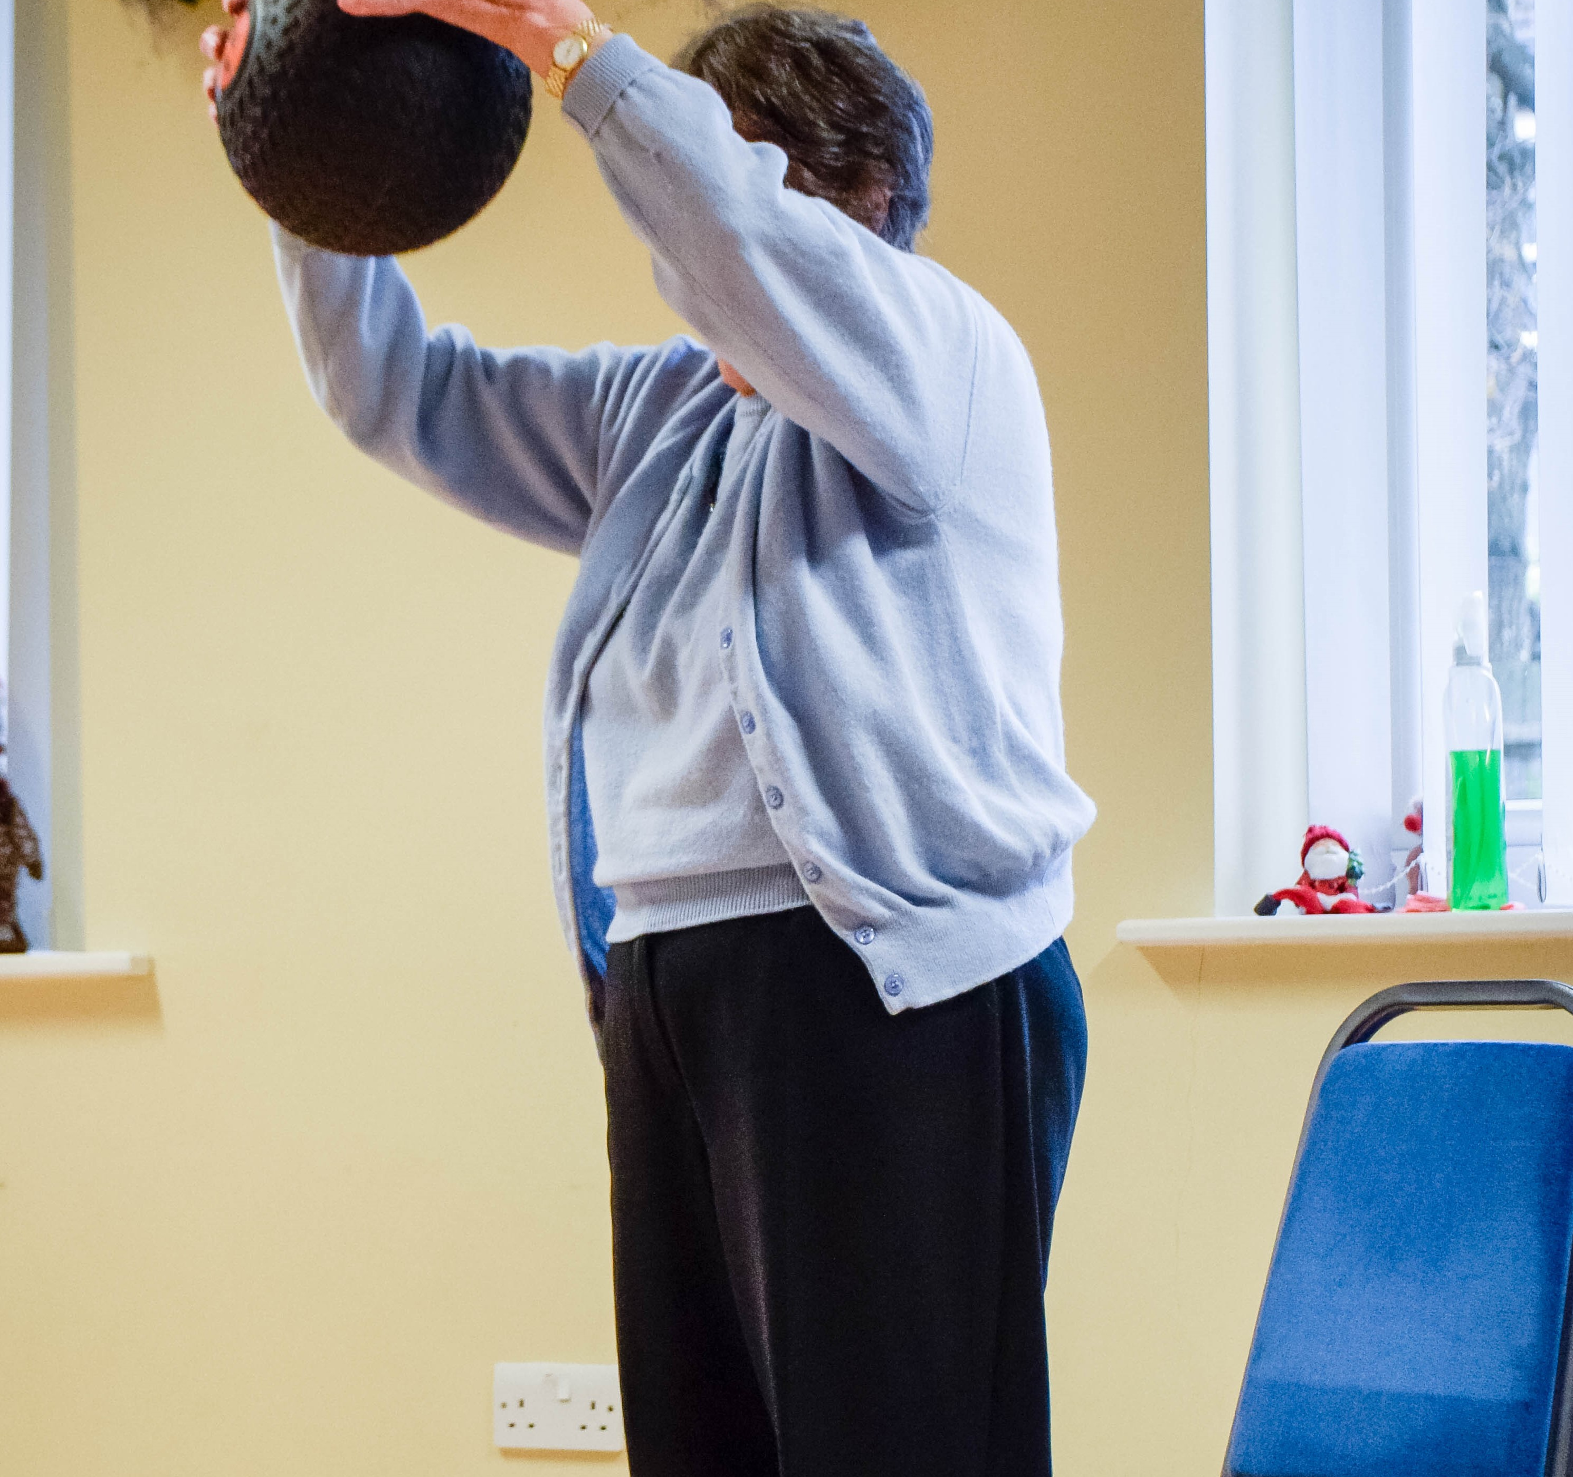
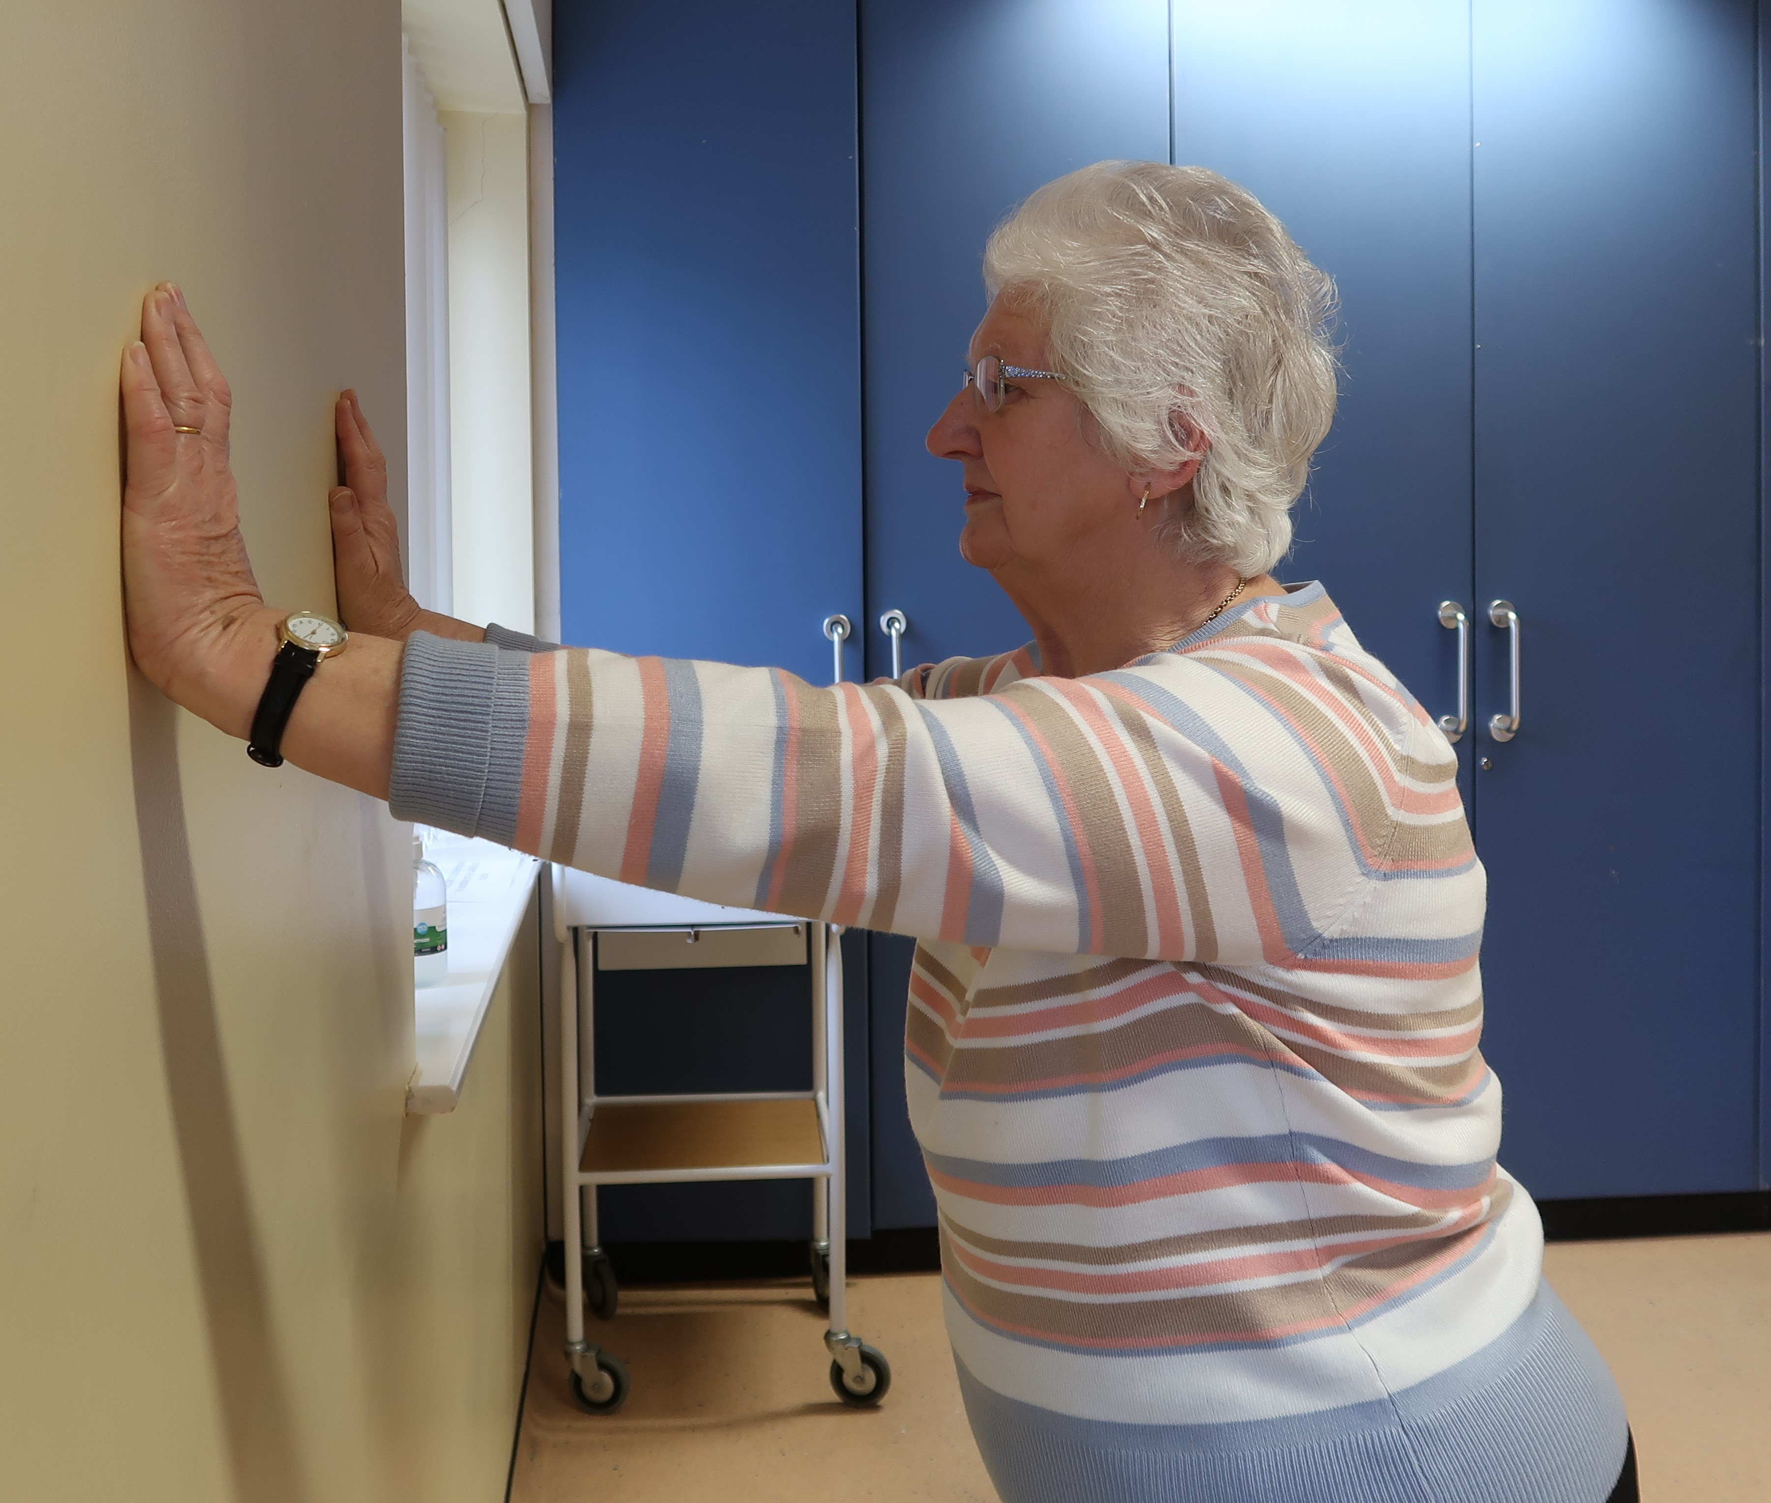
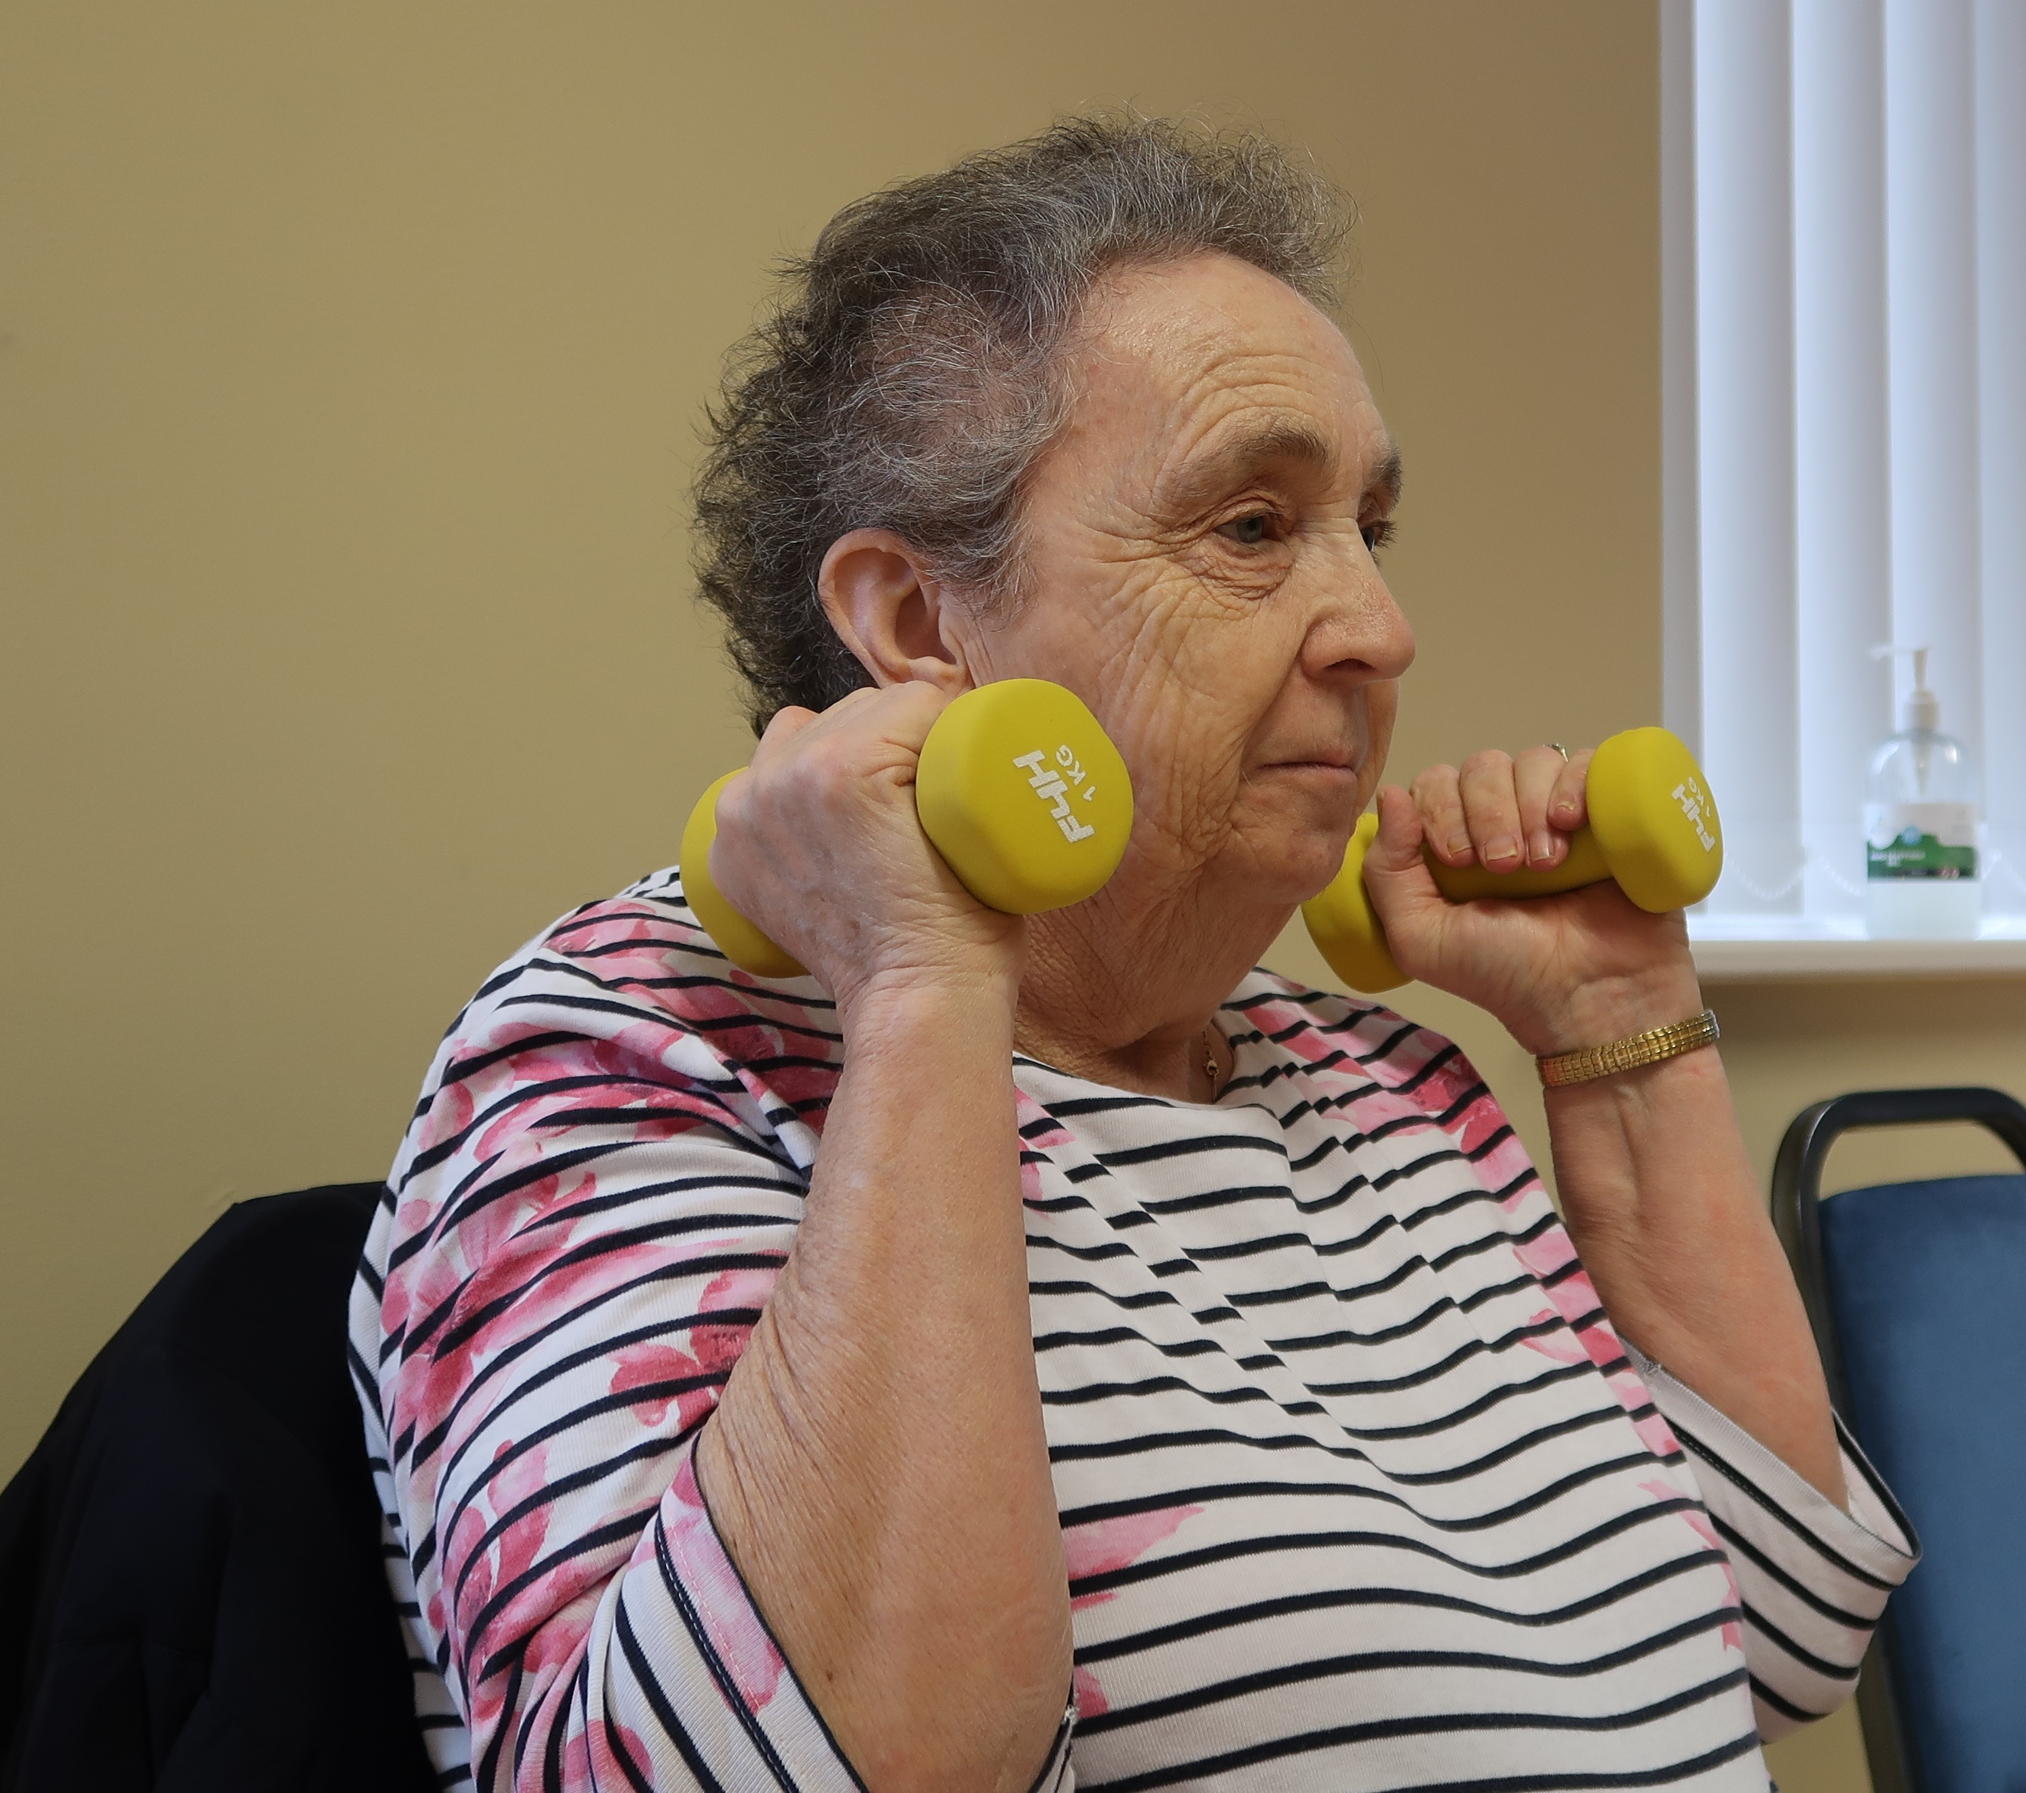
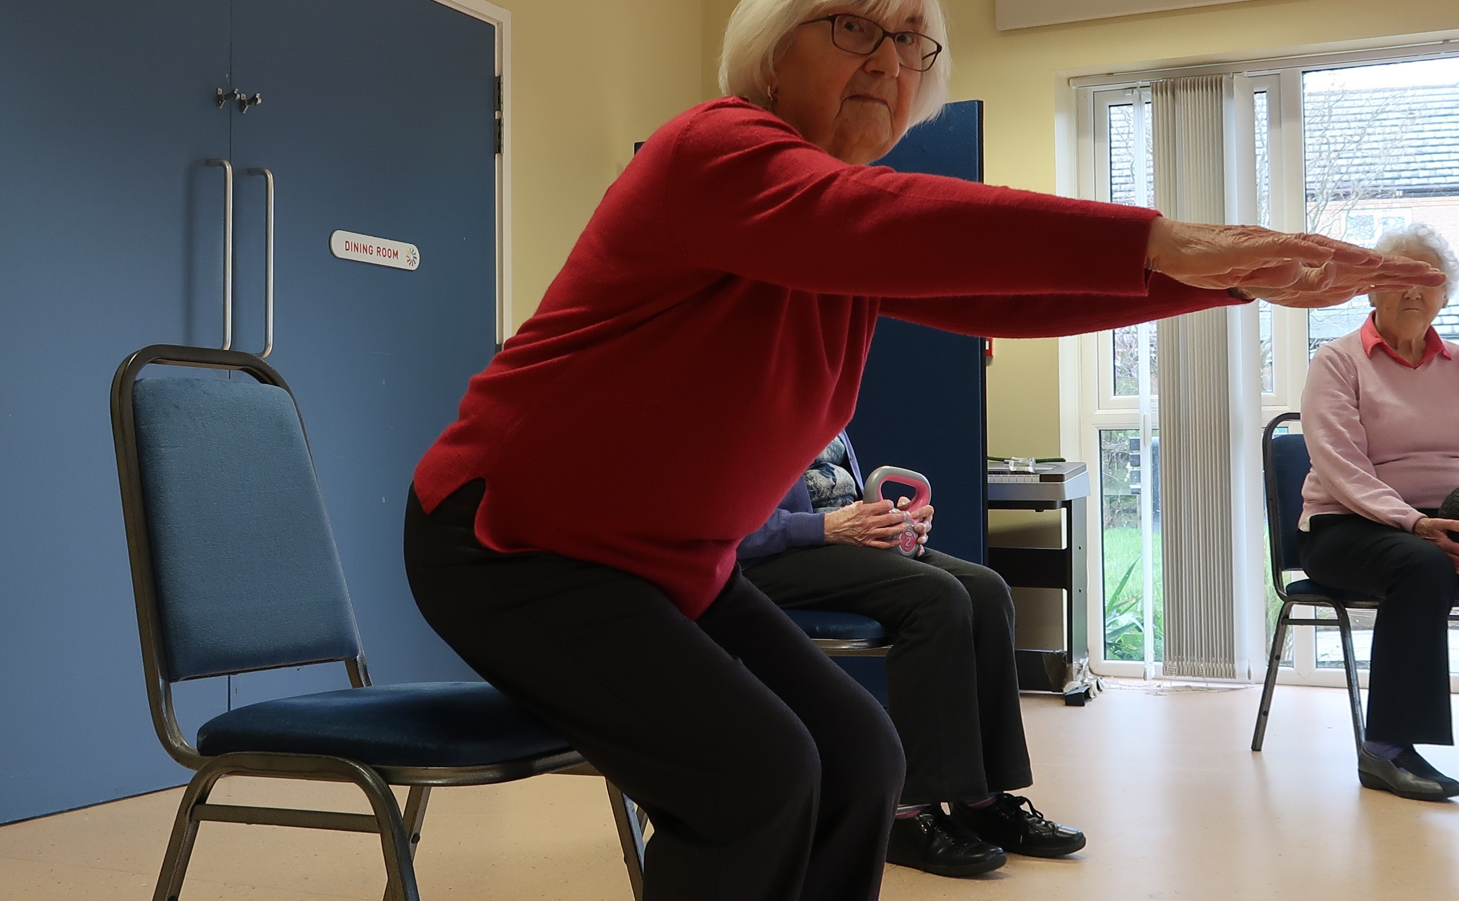
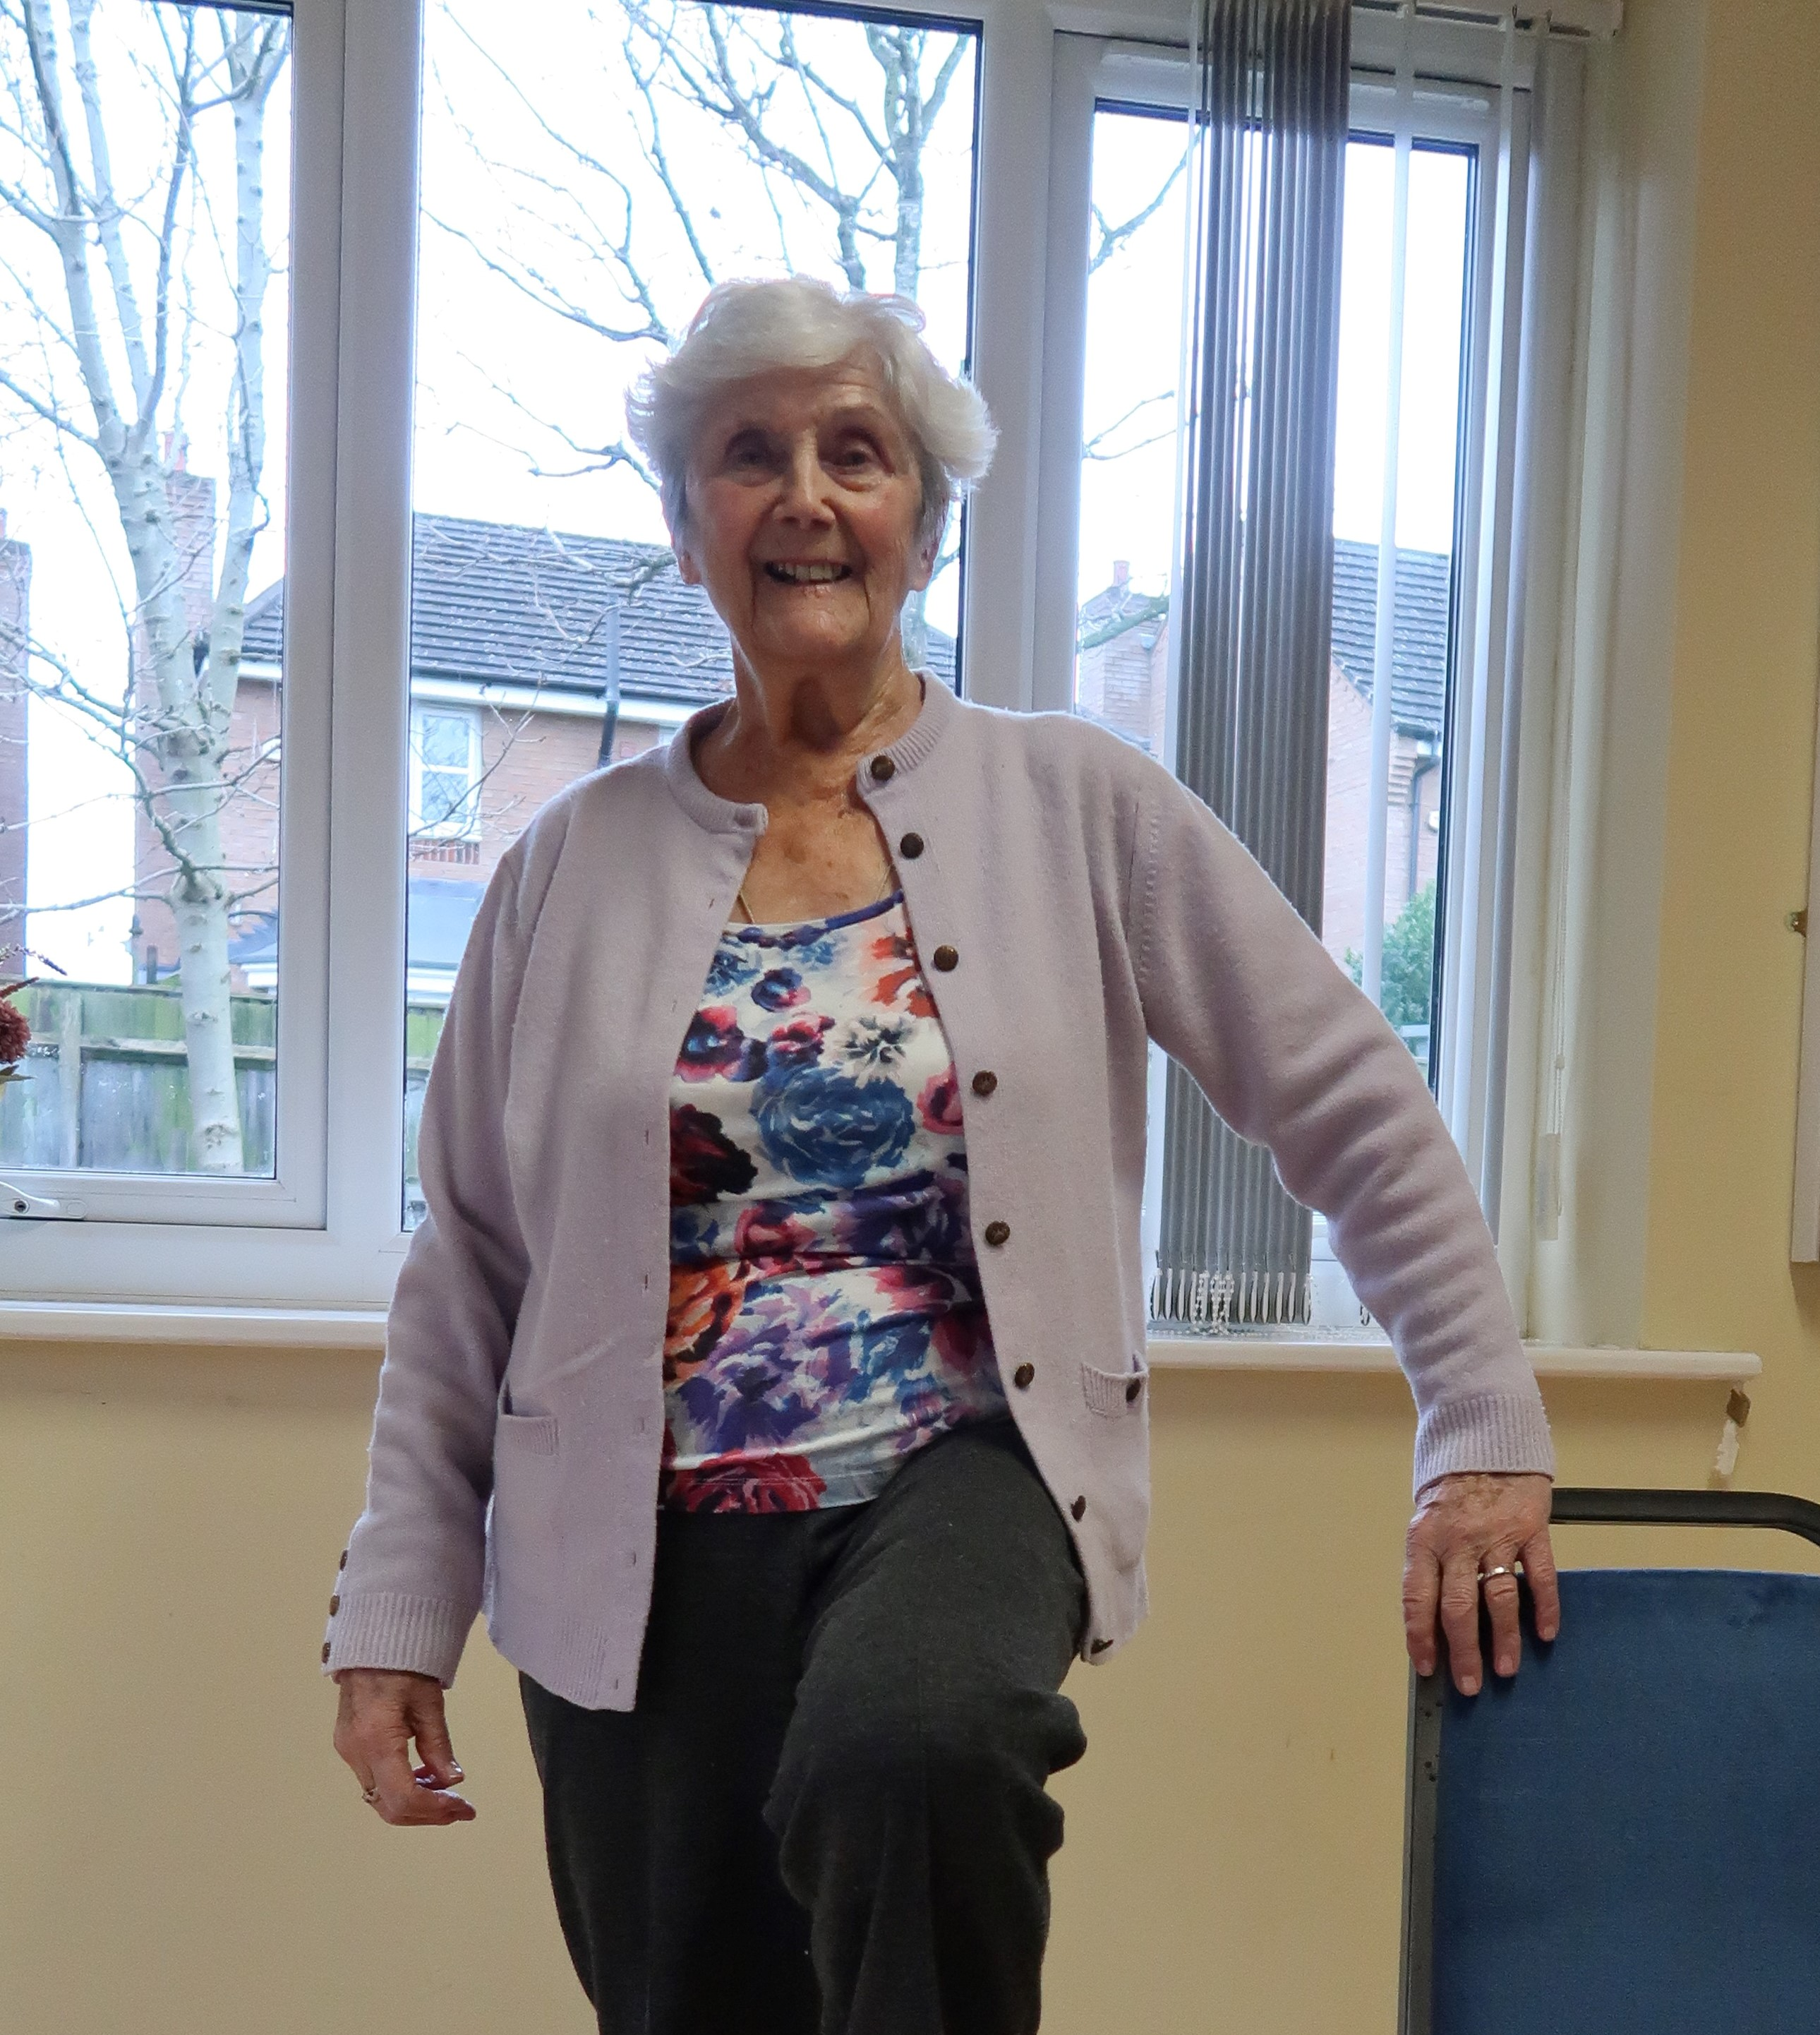
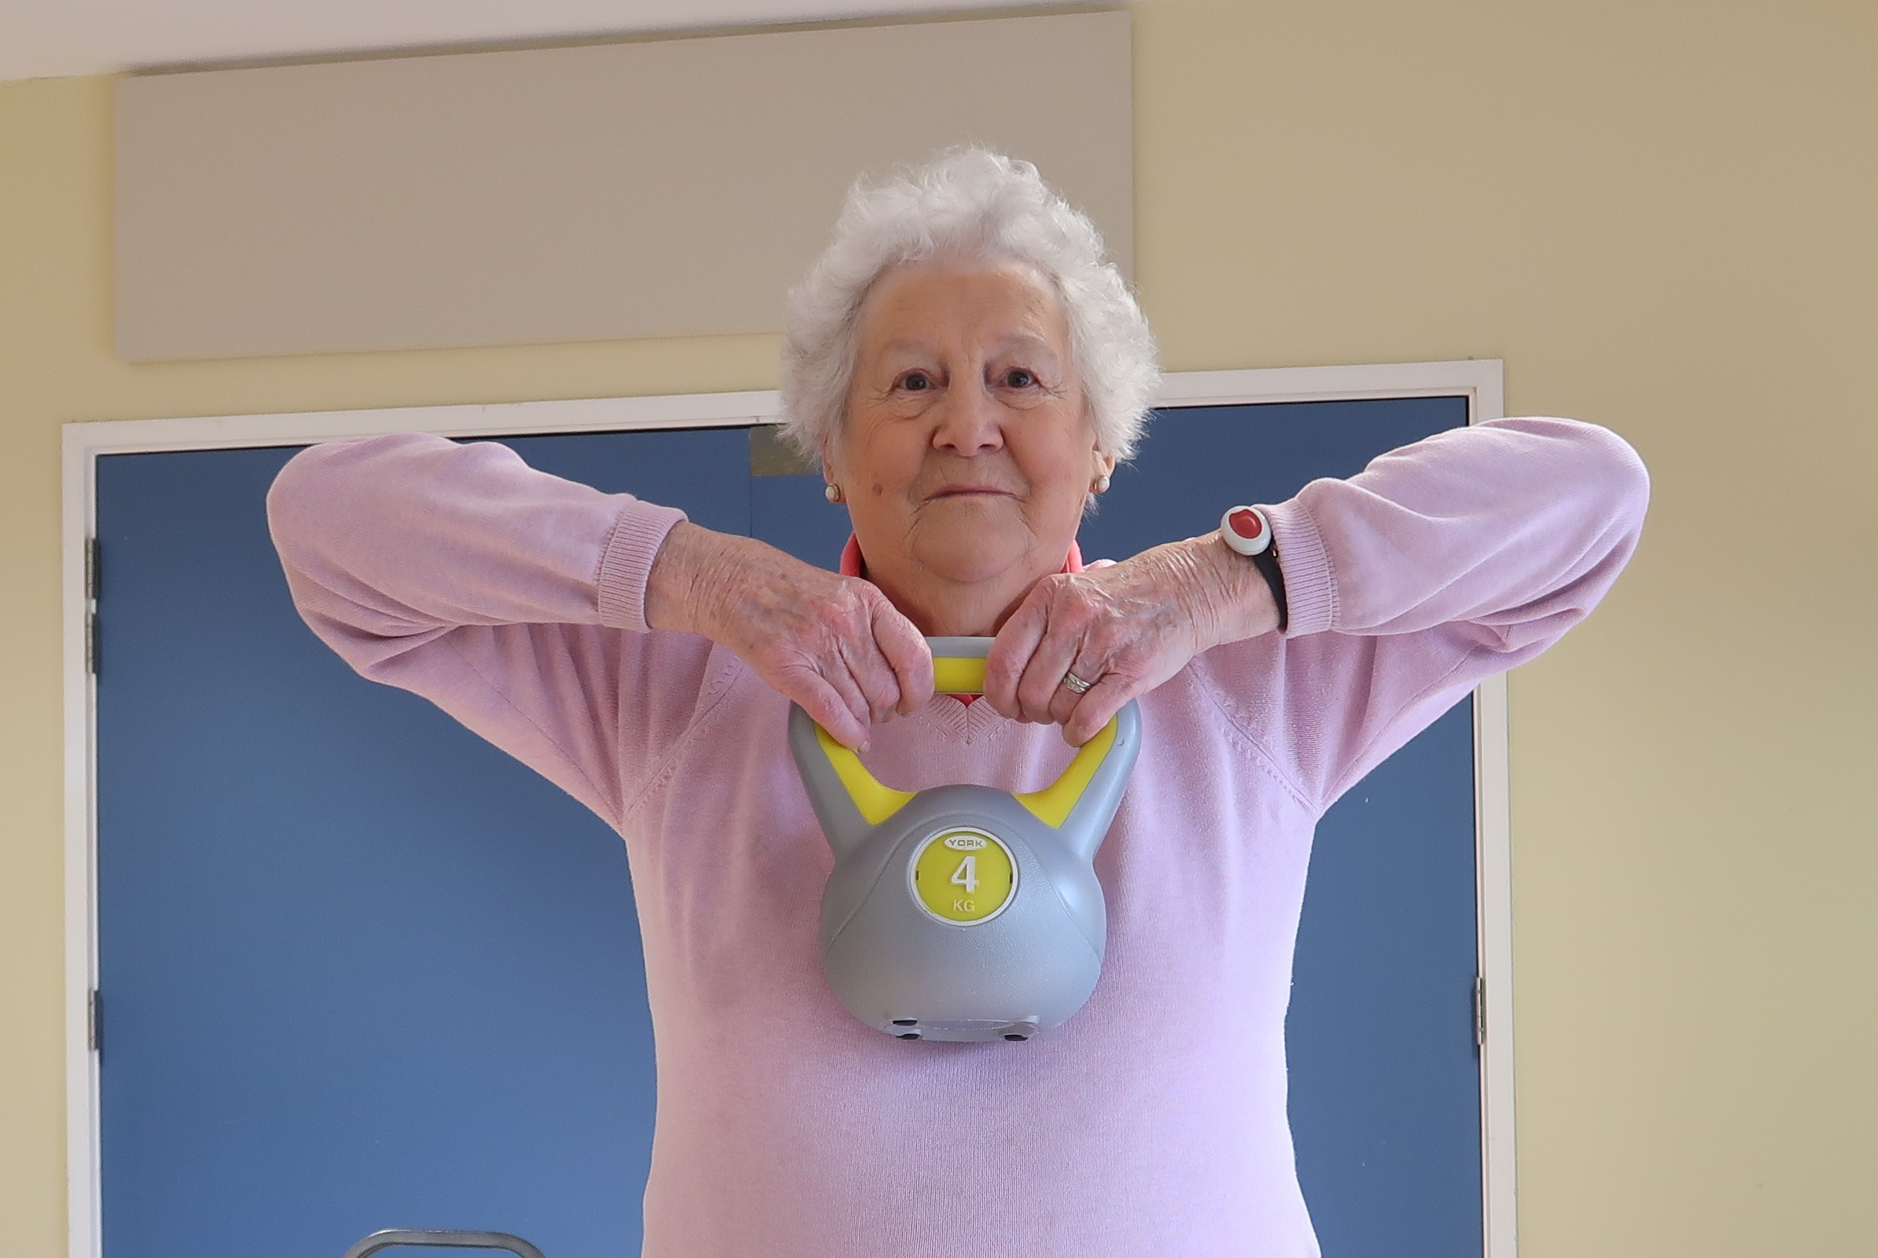
Physiotherapy-led tailored exercise programme
Exercises were tailored to each individual, and followed a set of 12 progressive exercises that include:
Bicep curls
Shoulder press
Wall press
Mini squat
Tip toes
Hip abductions
Walking
Throwing and catching
Upright rows
Marching on the spot
Crab walking
Pull aparts

Slide 5
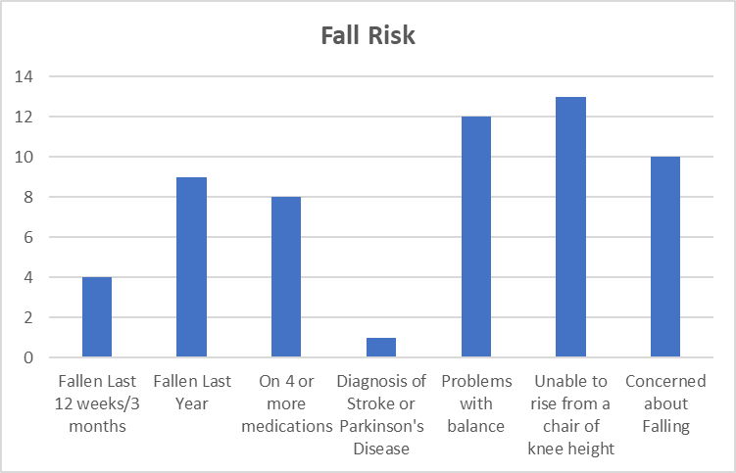
Fall Risk Assessment and Attendance
76% of suitable participants completed the 12-week course (and had both the MOT at baseline and follow-up completed for analysis):
9 had previously had a fall in the last 12 months; 1 of whom had accessed emergency services in relation to their fall.
Age: mean age was 77 years old
Gender: 14 were female, 2 male
Disability: 11 had a registered disability
*1 participant completed the course however didn’t attend the final follow-up assessment due to hospital appointment. Currently being followed up separately so has not been included in the analysis at this point.
For reference, the percentage adherence to community exercise classes in the community for over 60’s is >69% (Faculty of Health and Social Science, Bournemouth University). Active Futures percentage adherence is above this for all cohorts ran to date.

Slide 6
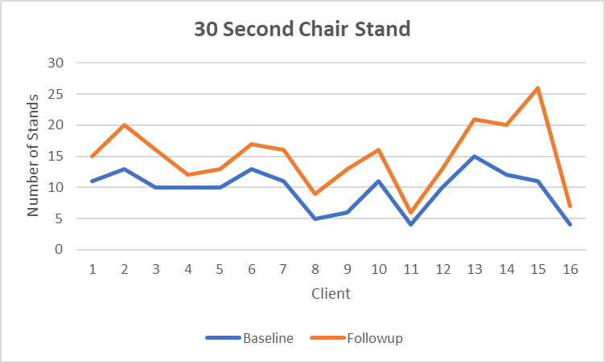
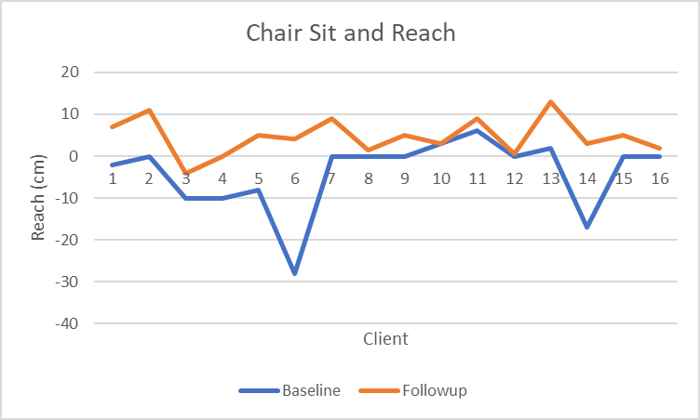
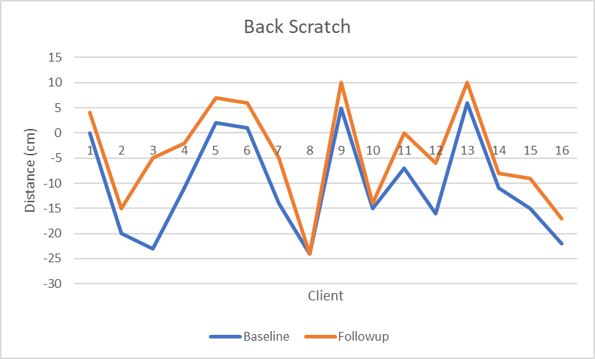
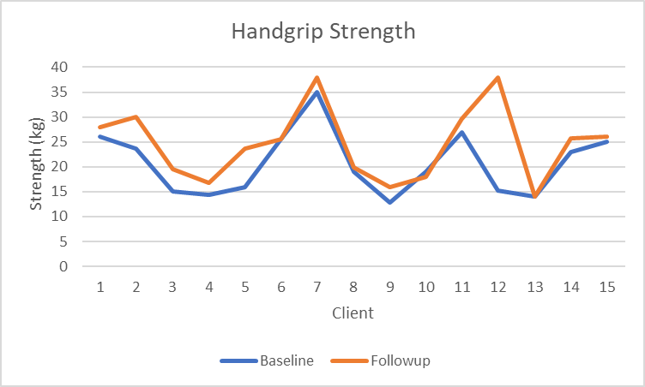
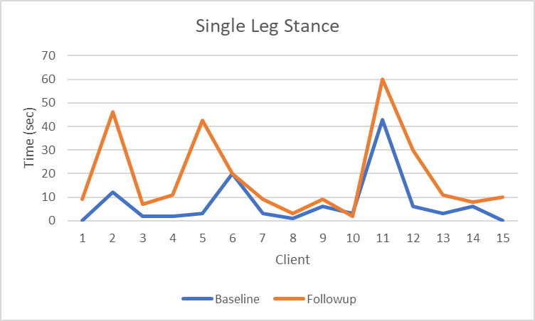
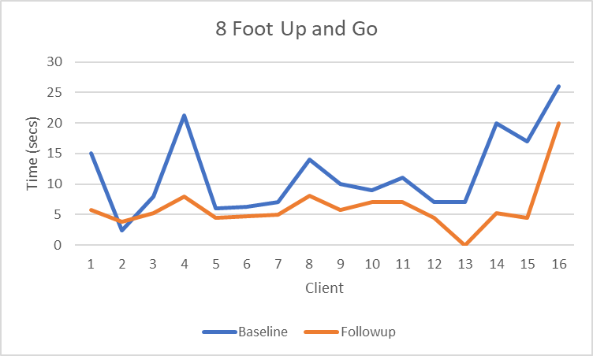
Results: Functional Fitness Test
100% participants improved with median of an additional 5 chair raises being performed, from 9.75 to 15 stands
94% of participants saw an improvement in reach. Median improvement by an additional reach of 7.5 cm
94% of participants improved their back scratch reach, with a median improvement of 5 cm
94% participants were able to reduce their time taken to complete the test, with a median of 4 seconds improvement seen
87% of participants improved upon their time able to maintain a single leg stance, with a median increase of over 8 seconds.
81% of participants improved upon their handgrip strength, with a median increase of over 2.7 kgs.

Slide 7
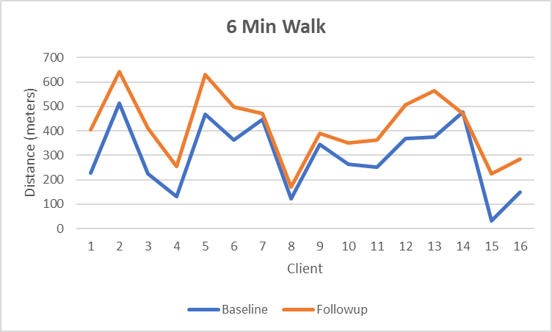
Results: Functional Fitness Test
94% participants increased their walking distance from baseline to follow up; the median distance travelled increased by 132 m
One participant increased their distance from 226m to 406m in 6 minutes and therefore after the 12 weeks was within the average range for the participants age and gender

Slide 8
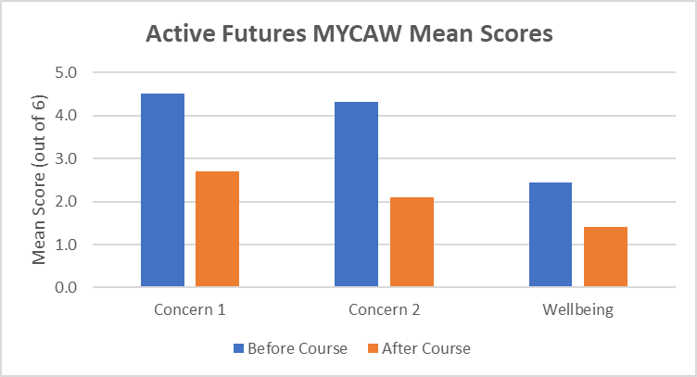
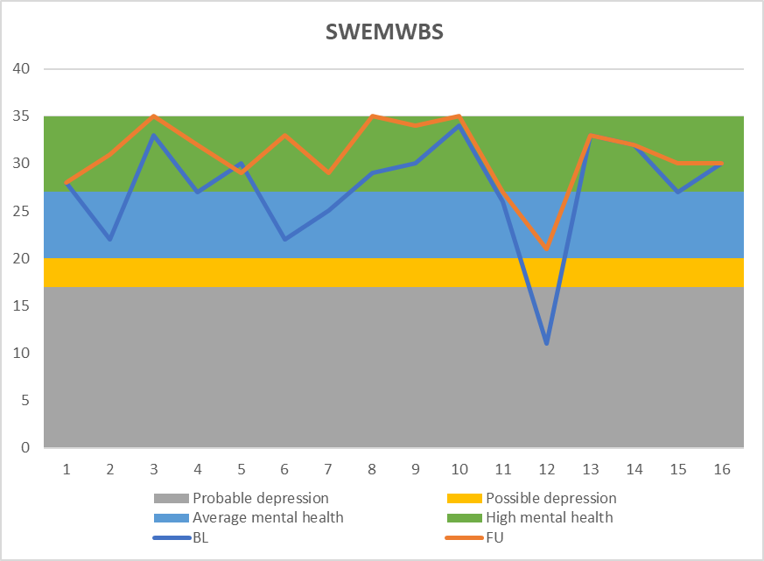
Results: Emotional Wellbeing and Mental Health
Measure Yourself Concerns and Wellbeing (MYCAW)
Concerns and issues highlighted at the start were broadly:
  Balance
  Strength
MYCAW results repeated after 12 weeks saw an improvement in all 3 MYCAW indicators
Short Warwick Edinburgh Mental Wellbeing Scale (S)WEMWBS
75% participants saw increase in their SWEMWBS score, with 1 participants moving from ‘possible depression’ to average mental health’.
The mean score at baseline was 27.4 (average mental health) and at follow-up 30.9 (high mental health). A change of 3 or more points can be considered significant.

Slide 9
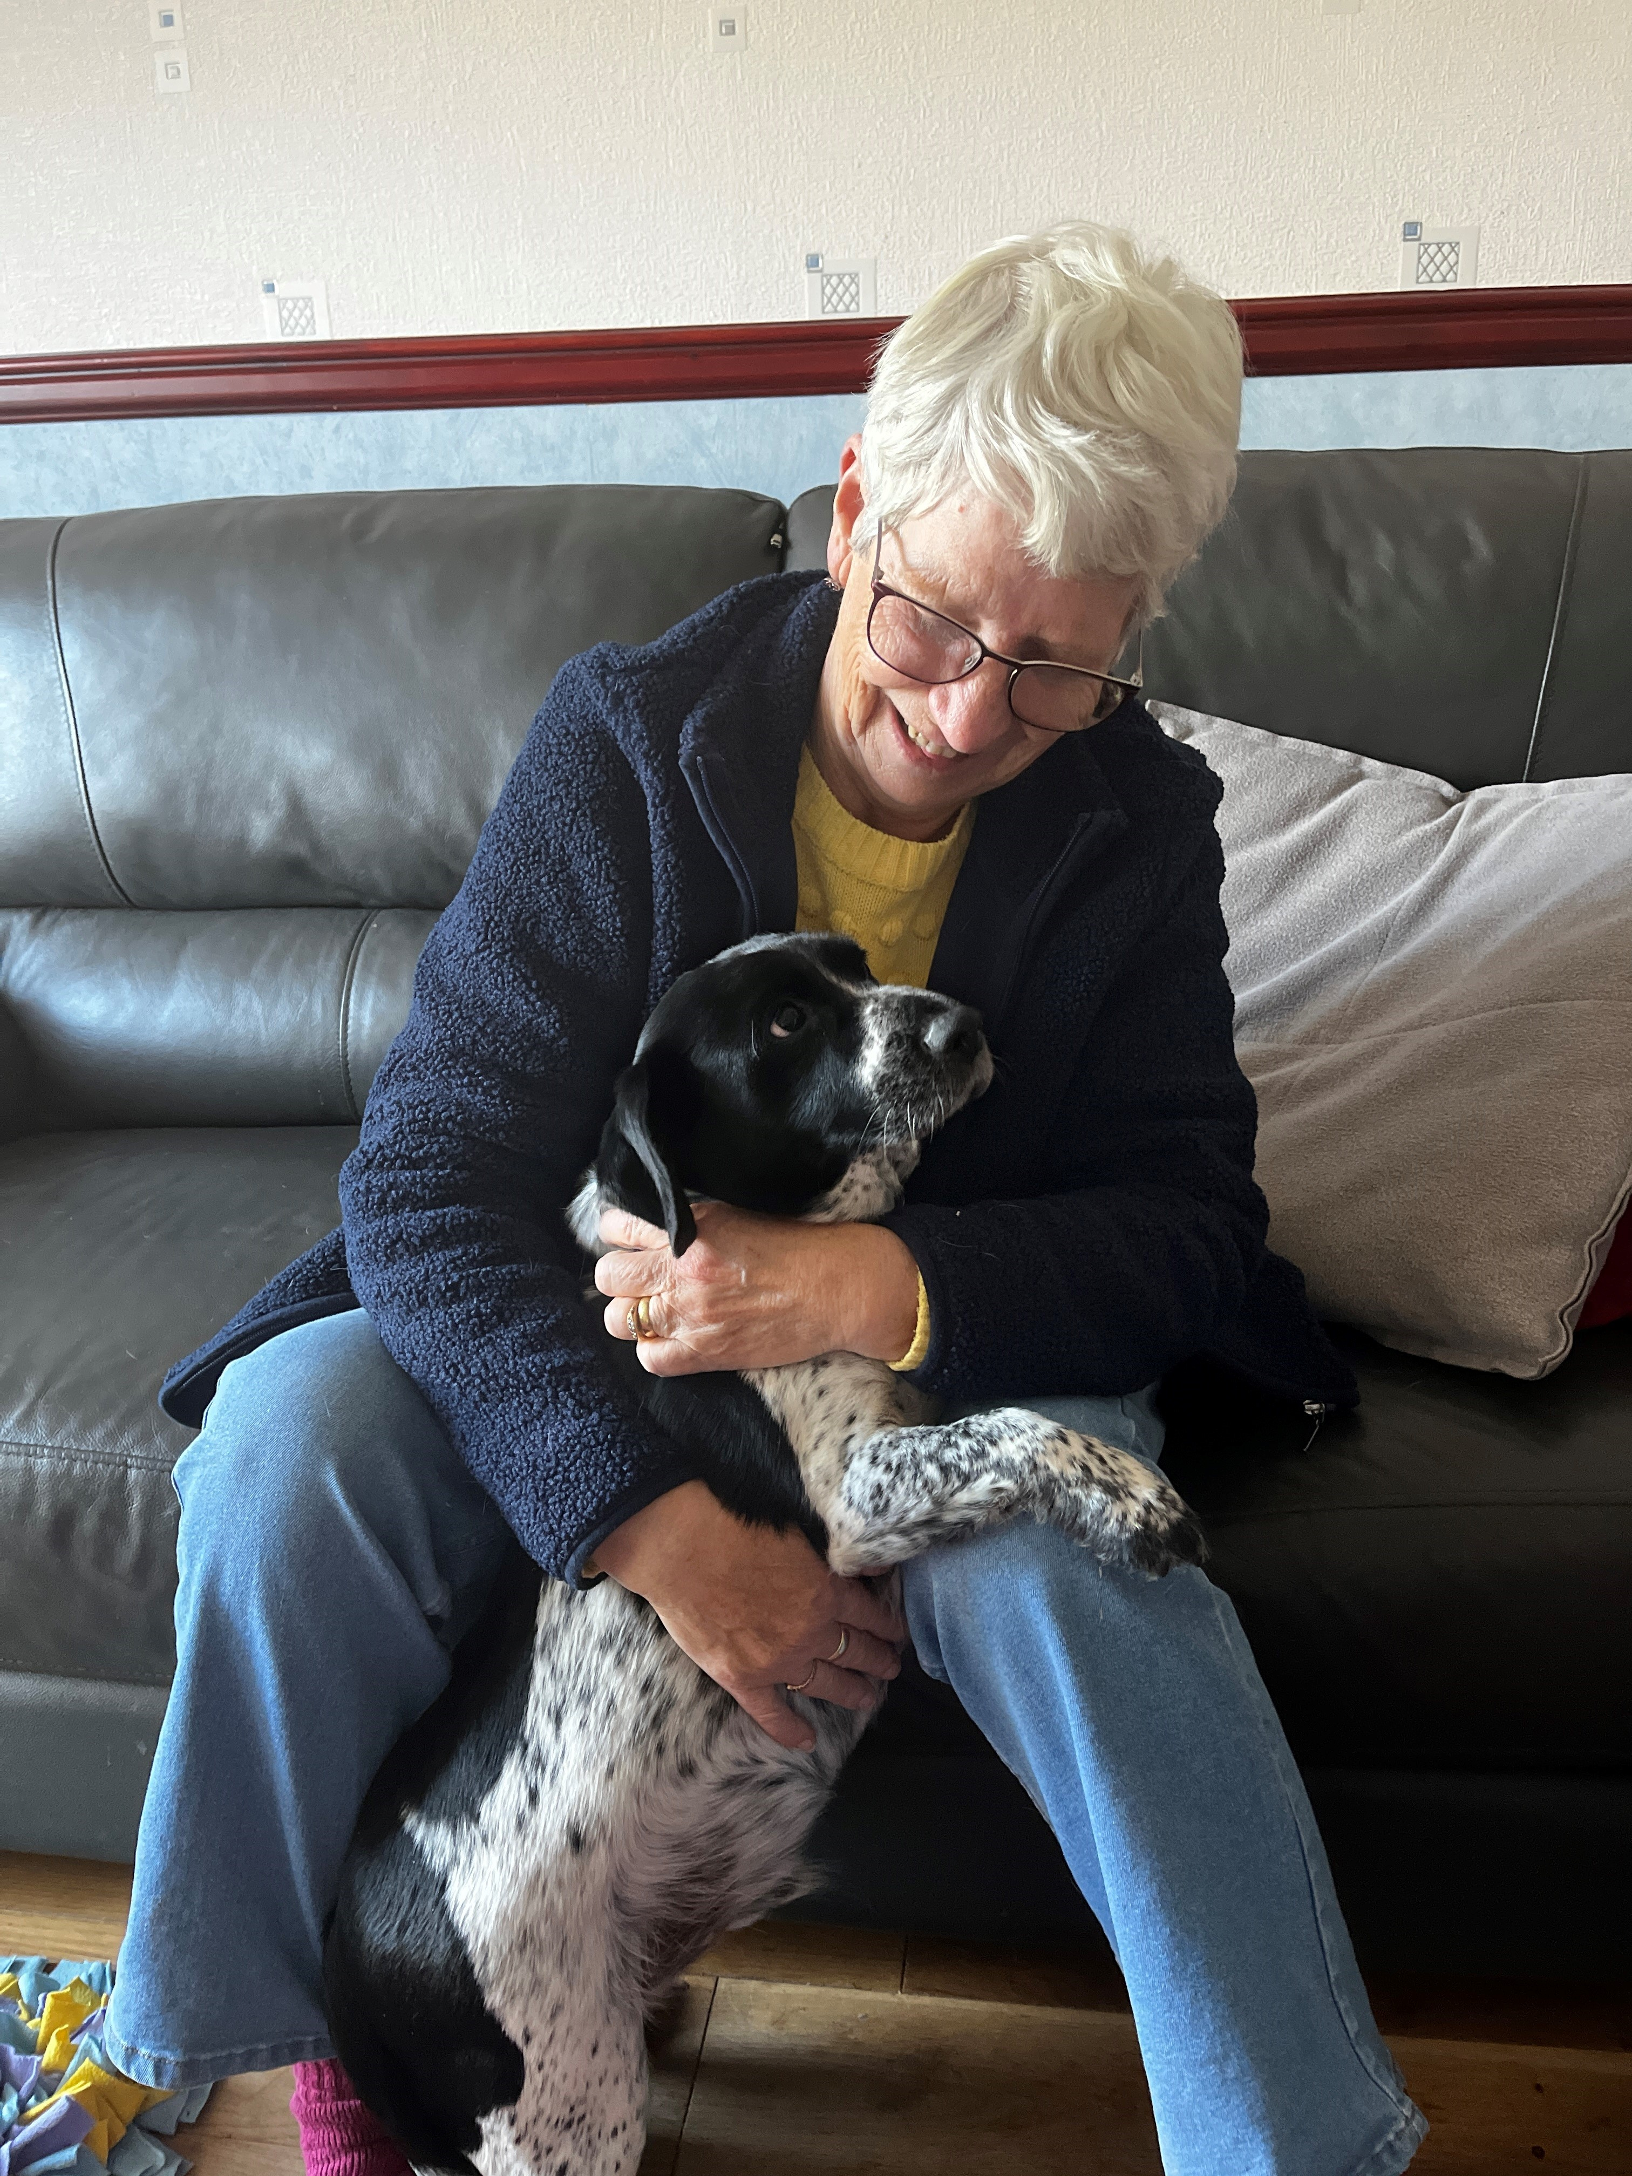
Joan’s story
Joan is 75 years old and lives with her dog JB.
Joan suffers from arthritis and in the last year Joan’s health has been deteriorating, she has been increasingly struggling with her mobility, strength, and balance which led to her having a fall whilst in the bathroom.
‘Before [Active Futures] everything was time consuming and it was frustrating being like that, I couldn’t open a jar, so if I wanted some jam I would have to wait for someone to visit. My son did my shopping as I didn’t have the confidence to go out. You get to a stage where you feel ‘I won’t bother’.”
Results from Active Futures show Joan has made significant improvements:
Handgrip Strength had increased by 3kg
30 Second Chair Stands doubled after the 12-week programme
5cm increase in reach with Back Scratch test
“I really got a lot out of [Active Futures]. It’s given me strength and confidence, I go out more and do my own shopping now, things like that. Jane got the falls team out to me and they are putting a grab rail in the bathroom, she also helped me with Attendance Allowance, which has made a real difference (an extra £100 a week) and means when it’s really cold I can leave the heating on. I’ve also got a blue badge which supports me to be more active”
I am proud I can now open a jar. When I first tried, I was about to give up and I thought ‘no give it a go’. So I tried again, and I opened it. For first time in 2 years I’ve been able to open a jar by myself!’ I’m doing Fit Futures and will keep going because Active Futures has made such a difference to me.”

Slide 10
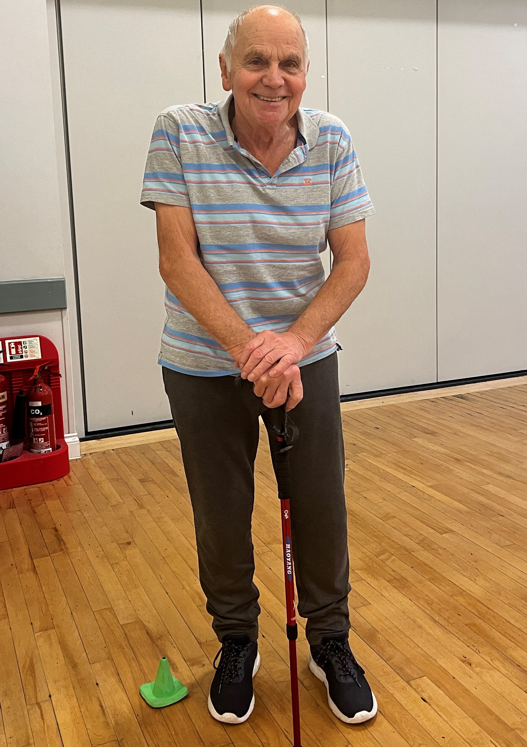


Bob’s story
Bob is 78 years old and lives with his wife. Bob had fallen in the last 18 months, was waiting for a hip replacement, he reported having issues with balance and mobility which resulted in him feeling anxious.
‘I’ve had two knee replacements and have arthritis in both my hands and shoulders. I’d seen a physio and had exercises to do at home, but I’d get distracted so didn’t do them really. I was discharged from physio but needed something more. I’d still hold onto furniture (to move around) and found it difficult in the garden. I would have to stop and get my breath back after every few steps.’
Results from Active Futures show Bob has made significant improvements:
6-fold increase in the distance of a 6 min walk (from 33 meters[2 HGV’s] to 225 meters[14 HGV’s]) in 6 minutes
8 foot up and go reduced time by 12.52 seconds, surpassing the average range for the test
40% increase in chair stands (from 11 to 26) in 30 second test
‘I most enjoy exercising with other people who are all in same position. I don’t get opportunity to get out of house and meet people like this. I have stuck to doing the exercises and even do them at home, as I feel motivated exercising with others.
I know exercising before my hip operation is important for my recovery. The encouragement here gets you moving. After [Active Futures] I do more things around house now, and get more things done myself.”
That’s a distance travelled of 2 HGV’s (33mtrs) pre assessment…to 14 HGV’s (or 2 football pitches)post assessment…go Bob!

Slide 11
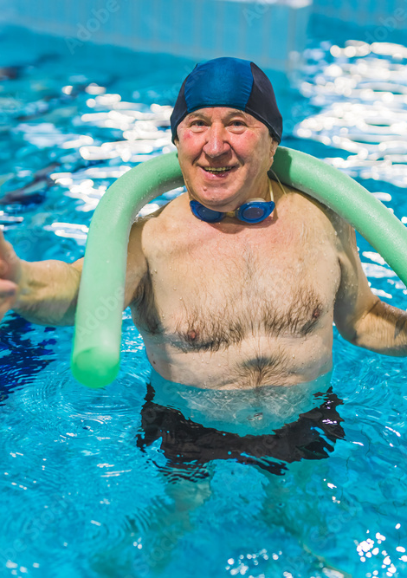
John’s story
* Name has been anonymised
John is 77 years old and has angina, asthma and an overactive thyroid. John wanted to improve his energy levels and weight loss was also important to him at the start of active futures.
After initial assessment, the wellbeing team identified that John would benefit from referral to falls prevention service, access to a community agent, and telecare.
Results from Active Futures showed John has improved:
  increased flexibility in Chair Sit and Reach test by 9cm
  increased flexibility in Back Scratch test by 13cm
  increased from 11 chair stands at baseline to 16 chair stands at the end
  increase of 6 second in single leg stance, moving John into the average range for his age and gender, from below average at baseline
John has lost weight, is physically fitter and is more able to self care. He is feeling motivated with more energy for everyday life, has started swimming and also joined a walking group as well as Fit Futures.
John particularly noted he had fun during the 12 weeks attending, he felt it was a great way to get out of the house and socialize and John is now motivated to keep going on his health journey.

Slide 12
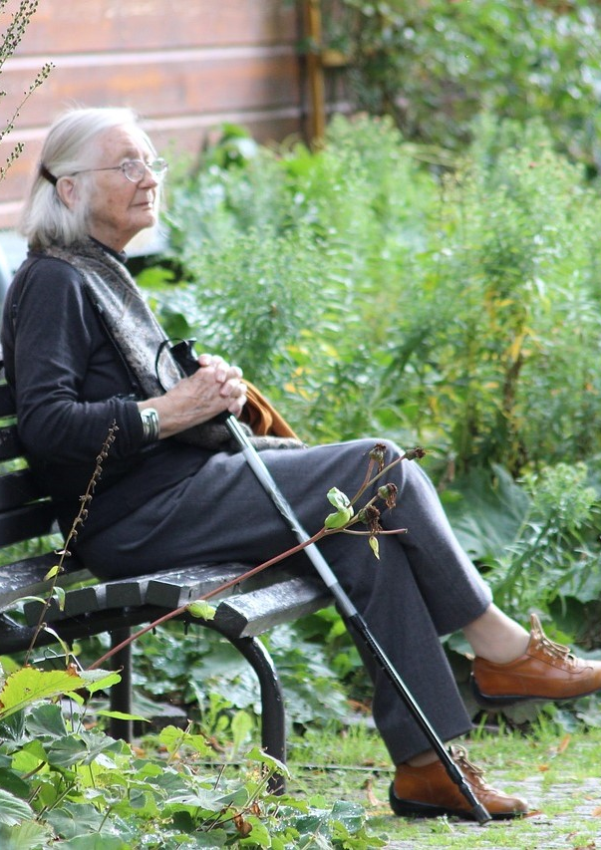
Michelle’s story
* Name has been anonymised
Michelle is 72 years old, and is registered blind she suffers with heart failure, diabetes type 2 and lymphoedema.
Prior to starting the Active Futures Michelle had two falls in the preceding two months. Michelle had suffered from pain in her chest when not exercising and had lost balance because of dizziness. Michelle is on prescription medication for her blood pressure and heart condition.
Results from Active Futures shows Michelle’s physical health improved significantly:
  Handgrip increased from 13kg to 16.7kg
  90% increase in 6-minute timed walk (from 150 metres to 285 metres)
During Active Futures, Michelle was referred to the GP based social prescribing team for mental health support, she was also provided with welfare rights support and a fire service home safety check.
Michelle’s mental health had been affected by a situation with her carers, and this reflected in her post assessment mental health scores. The wellbeing team were concerned so followed this up with Michelle and her family and have resolved the issue that was causing her distress. Michelle is now more engaged with the services and changes to her carer arrangements have improved her mental health. Michelle has also been signposted to Rainbow Foundation’s Day Opportunities Service to support her to maintain her improved independence and ongoing wellbeing.

Slide 13
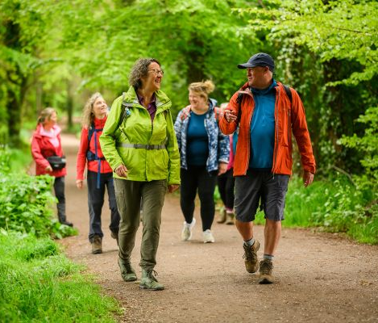
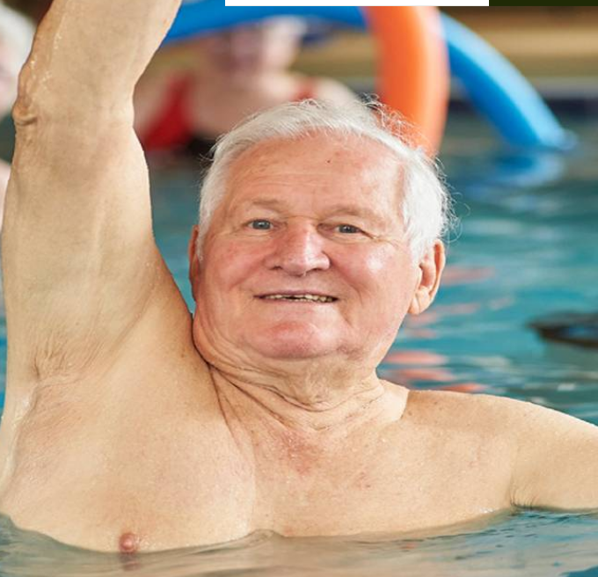
The difference it has made to me…
‘I’m ready to start living life again
and have even booked a holiday abroad’
‘I can swim now and am leaving my stick behind most times I go out’
‘I can now open a jam jar, instead of waiting for a visitor to do this for me’
‘keeping mobile means everything, just being able to walk to the bus’
‘I’m motivated to do things, I‘ve started swimming and also joined a walking group’
‘I’m happier and getting out a lot more’ ‘I have made some good friends’
‘I can now push my grandchild in their pushchair and am doing more with my family’

Slide 14
Cost Effectiveness of Active Futures
The Active Futures Programme aim is changing health behaviours. The classes focus on strength, balance, mobility and cardiovascular fitness have been designed to be fun, socially active and intended to build a sense of community. It is estimated only 1 in 10 of those aged 65 and over are active for 150 minutes per week (physical activity guidelines for older people, www.nhs.uk) 44% of people over aged 65 have some form of disability. Mobility problems are most reported by people aged over 65, these problems contribute to poor quality of life and in turn high costs of health and social care.
The majority of Active Futures participants have progressed to fit futures and have reported and evidenced behavioural changes that have positively impacted their overall physical health and wellbeing.
The social return on investment of the Active Futures Programme is based on results of July cohorts is £1 : £10.10. This means for every £1 spent on the programme, the measure of social impact makes in economic terms is £10.10 across health and social care. This value was calculated using the following outcome metrics
Increased self-esteem
Improved sense of community
Being a member of a social group
Improved physical health
Reduction in GP/nurse visits
Reduction in A&E attendances due to falls
Reduction in ambulance call outs due to falls
Reduction in hip fractures

Slide 15
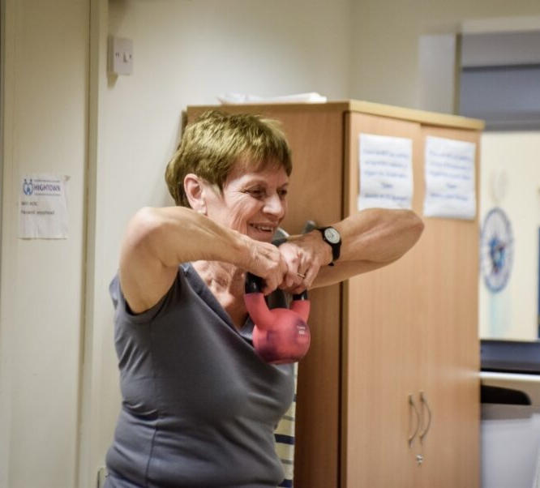
Lessons learnt and next steps
Short time scale from contract awarded to service commencing impacted on the availability of suitable spaces which meant the number of people who could attend 1 programme in the July cohort was reduced by 2 from the outset, this was mainly due to timescales between contract awarded and start date. Venues for Nov 23 cohort have a capacity of 12.
Would welcome an opportunity to work with NERS and local GPs to:
  increase awareness of service, and positive impact on the physical and mental health of older people.
  gain an understanding to barriers to referral
  to target patients on frailty registers and those with MSK conditions to access the course.

Slide 16
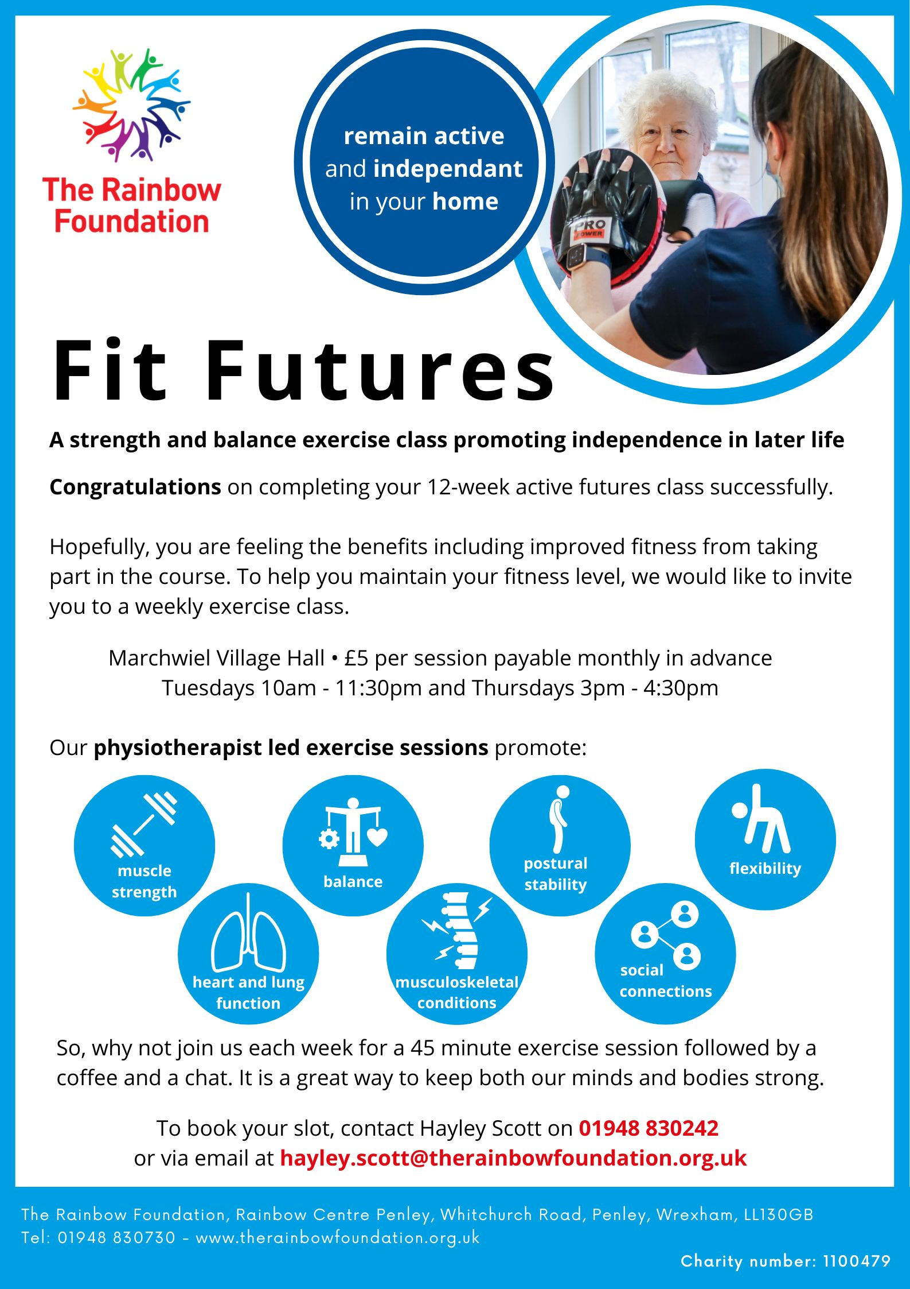
Going Forward
Participants are graduating to ‘Fit Futures’
Next new cohort running from 3 locations: Acton, Chirk and Marchweil.
Cohort at full capacity with 12 per session.
Attracted match funding to run an additional programme for each quarter, with funding from the Shared Prosperity Fund (UK Govt.)
Help from Primary Care
How do we work with GP Practices and GPs to increase awareness of sessions and increase referrals?
How do we identify people who would benefit, MSK conditions living with pain, frail older people, falls patients discharged from hospital?
How can we work with primary care to support more self-referrals from older people and their families/carers, particularly men who are underrepresented and less likely to self-refer?

